Slide 1
ENSE 470 - Milestone 1
Group: Timbits
Maksym Zabutnyy, Earl Macalino, Jennifer Herasymuik
January 18th, 2018

Slide 2
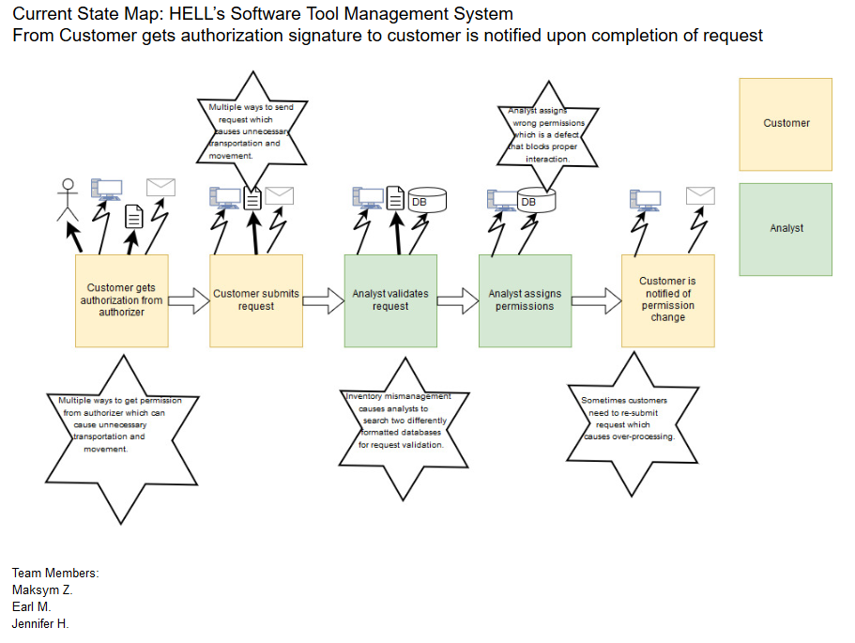
Current State VSM
Notes:
Talk about VSM
process flow & types
Kaizen bursts (TIMWOOD)
Any other discussion points
How will this help design a better future state

Slide 3
Reflection
How did you feel about this milestone? What did you like about it? What did you dislike?
Tough to get together for the first time. Using tools that help us.
What did you learn about yourself as you collaborated and worked through this milestone?
We are information intensive, we wrote down a long list of Kaizen Bursts before choosing which one to use
How will you use what you have learned going forward?
Work in a document throughout, compile information when we meet.
What “stuff & things” related to this milestone would you want help with?
Access to potentially a standard tool, knowing how to group less “significant” Kaizen Bursts and dealing with duplicate Kaizen Bursts.
Notes:
How did you feel about this milestone? What did you like about it? What did you dislike? [Response here] What did you learn about yourself as you collaborated and worked through this milestone? [Response here] How will you use what you have learned going forward? [Response here] What “stuff & things” related to this milestone would you want help with? [Response here]

Slide 4
Questions?

